Slide 1


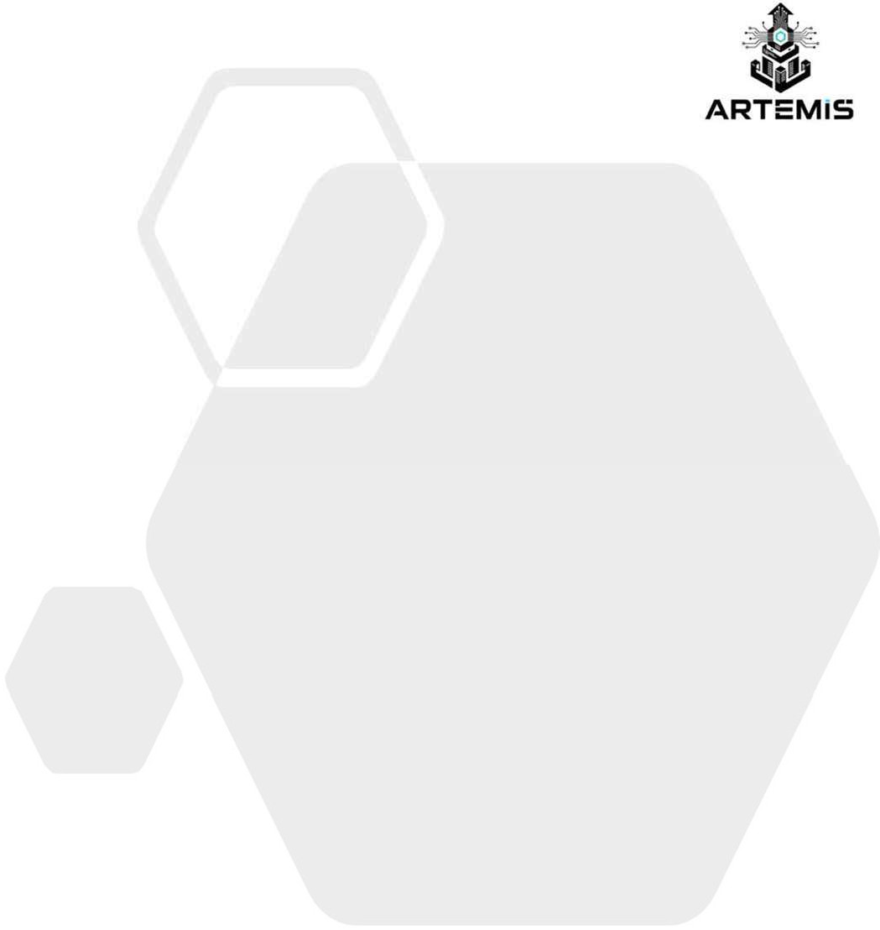

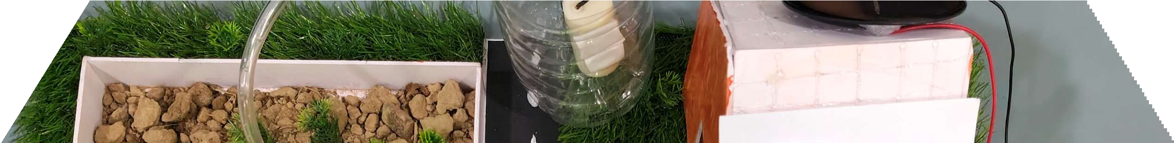
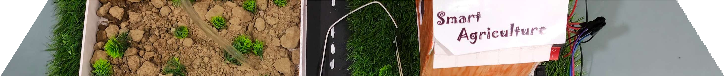
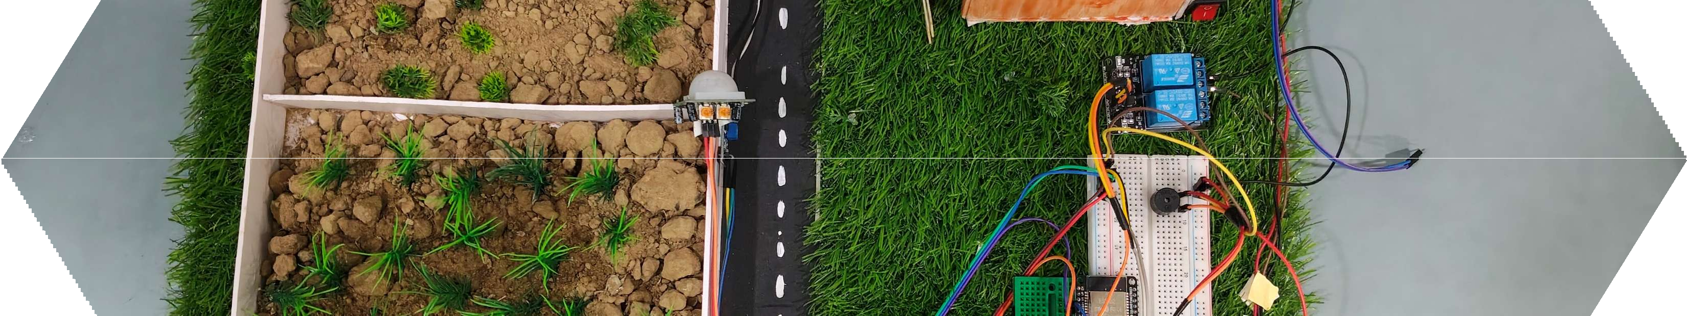
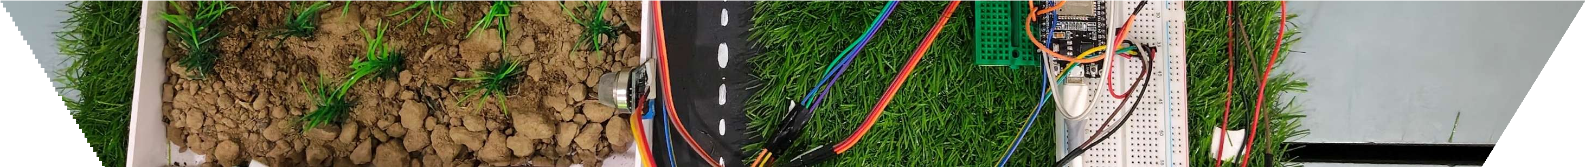
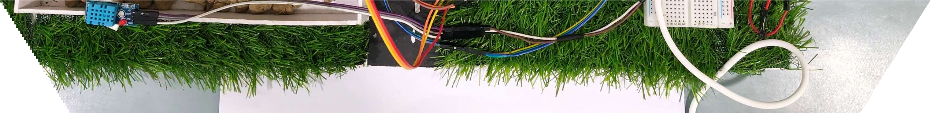

ARTEMIS HACKATHON 2026
TITLE PAGE
Problem Statement No –1
Problem Statement Title- Smart Agriculture Monitoring System
PS Category- Software/Hardware
Team Name - Falcon 1.1

Slide 2


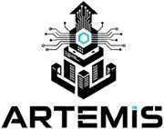
PROB LEM STATEMENT
Describe the problem clearly:
Traditional irrigation wastes water due to fixed schedules.
Farmers struggle with water scarcity and high costs.
Crops suffer from over-irrigation or under-irrigation.
Who faces this problem?
Farmers (small-scale and large-scale).
Agricultural communities in water-scarce regions.
Governments managing water resources.
Current challenges:
Lack of real-time soil moisture monitoring.
High labor and energy costs.
Environmental damage (soil erosion, salinity).
Real-world relevance:•Agriculture consumes ~70% of freshwater globally. Smart irrigation can reduce waste , improve yield, and support sustainability.
2

Slide 3


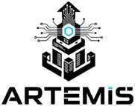
PROPOSED SOLUTION
Explain clearly:
Your concept:
IOT-based smart Agriculture Monitoring system.
How it works (high level):
Collect Data from Sensors → ESP32 → Monitoring
Main features:
Automated water control based on Soi Moisture.
Mobile app/dashboard for farmers.
Fire alert due to fire in crop field and Real time notification of all sensor data(Temp,Humidity,soil moisture)
Uses solar energy-efficient operation.

Slide 4



TECHNICAL APPROACH
Technology:
For hardware technologies we use ESP32,soil moisture sensor, DHT11,flame sensor , PIR sensor , relay module , pump moter , buzzer.
For software technologies we use C++ programming language.
Methodology:
Data collection : Data are collected from different sensors.
Data process : The ESP32 read the collected data and process then monitoring the system .
IoT Monitoring:Sensor data sent to Blynk Cloud and Cloud-based real- time monitoring via Blynk server . User view and monitors data through Blynk mobile app and Blynk web dashboard.

Slide 5



FEASIBILITY AND VIABILITY
Analysis of the feasibility of the idea:
Low-cost sensors and controllers are widely available.
Easy to integrate with existing irrigation systems.
Potential challenges and risks:
•
•
Sensor calibration and accuracy. Connectivity issues in rural areas.
Strategies for overcoming these challenges:
Use durable sensors.

Slide 6

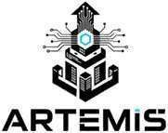
CHALLENGES & RISKS
Sensor Errors: Wrong data can damage crops .
Maintenance needed: Sensor and other component need regular check.
Lack of technical knowledge: Farmers may find it hard to use.

Slide 7


IMPACTAND BENEFITS
Social: Better crop yield, reduced farmer stress
Economic: Lower water uses & energy costs , low labor requirement.
Environmental: Reduced water waste, soil conservation

Slide 8


T A R GE T USERS
Examples:
Government(Agriculture Department): To promote water conservation and smart farming.
Farmers : To save water, reduce cost and increase crop yield .
Students: For learning and agricultural innovation.
Hospitals :To manage garden irrigation automatically and conserve water.
Urban citizens: For automated watering systems.

Slide 9


FUTURE SCOPE
AI-based crop prediction.
Cloud data storage and monitoring.
Solar-powered irrigation systems.
Expansion to urban smart farming.
Weather forecast based irrigation.
Mobile app integration for remote control.

Slide 10


BUSINESS MODEL / PROFIT ST RATEGY
Examples:
Government: Large-scale deployment in irrigation projects.
Farmers:Affordable kits sold directly.
Urban citizens:Smart irrigation for gardens/parks.
1 0

Slide 11



RESEARCH AND REFERENCES
Links:
www.fao.org
www.agricoop.nic.in
www.ijert.org
Reference:
Kumar,R.,et al.(2020)-IOT based smart irrigation system,IJERT.
Food and agriculture organization (FAO)-Water management in agriculture report.
Research:
Reduce water usage by 30%-40%.
Improve crop yield by 10%-15%.
Minimize water wastage & reduce manual labour.
1 1

